Slide 1
SENTIMENTAL ANALYSIS: TEXT CLASSIFICATION

Slide 2
Overview
In this section we are going to discuss about the concepts of Natural Language Processing (NLP), Text classification and Sentimental analysis using RNN.
© Edunet Foundation. All rights reserved.

Slide 3
Contents
NLP- Text Classification
Examples for Text Classification
What is Sentimental Analysis?
Types of Sentimental Analysis
DL Models for NLP
LSTMs
RNN
Case Study: Sentimental Analysis of IMDb Database

Slide 4
NATURAL LANGUAGE PROCESSING: TEXT CLASSIFICATION
The phrase "natural language processing" (NLP) refers to the automatic computer processing of human languages.
One of the core ideas in NLP is text classification.
The sentence may be fed into a text classifier, which will assess the content and apply applicable tags automatically.
Text classification is the process of assigning a class to the input text

Slide 5
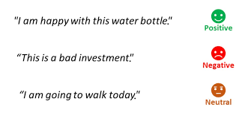
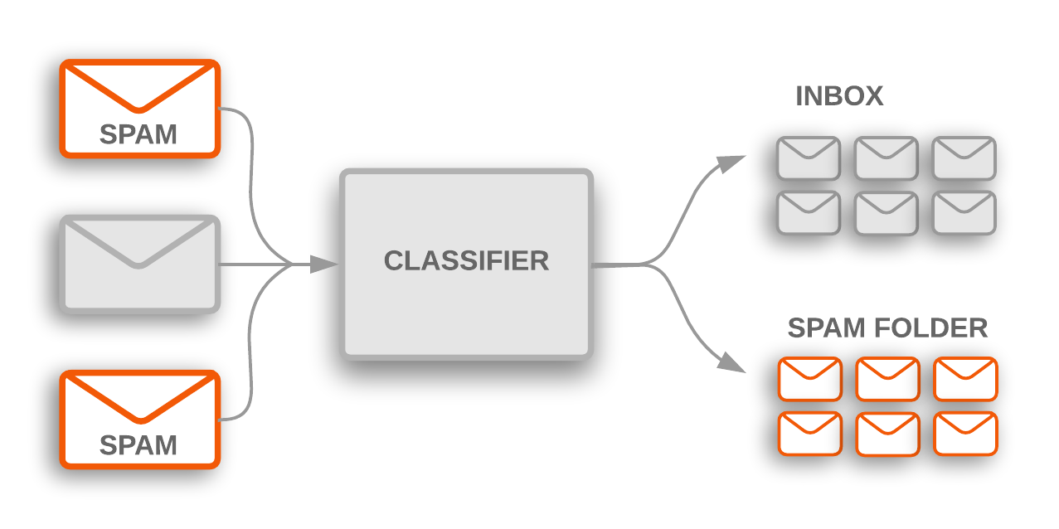
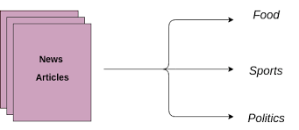
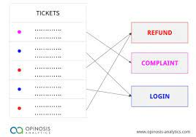
Examples For Text classification
Sentimental Analysis: Using social media to gauge audience sentiment
Spam and non-spam email detection
Customer requests are automatically tagged
News articles are categorize into predetermined subjects.
Notes:
What Is Document Classification?
Organizations need to classify documents so that their text data is easier to manage and utilize. For example, companies may need to classify incoming customer support tickets so they get sent to the right customer support agents.
Example classification of support tickets
With a manual approach, staff would need to sort through each text and assign a label or category to it individually. The problem is that manual classification can be time-consuming, error-prone, and cost-prohibitive.
That’s why many organizations are turning to machine learning (ML) and natural language processing (NLP) to automatically organize texts into one of several predefined categories. It doesn’t matter if the texts are very short (e.g. Tweets) or entire documents (e.g. news articles), the ability to quickly categorize this data brings efficiency to the organization and frees up staff to work on higher-level tasks.
5 Practical Text Classification Examples
With the value of text classification clear, here are five practical use cases business leaders should know about.
1. Gmail Spam Classifier
Spam has always been annoying for email users, and these unwanted messages can cost office workers a considerable amount of time to deal with manually. Most email services filter spam emails based on a number of rules or factors, such as the sender’s email address, malicious hyperlinks, suspicious phrases, and more. But there’s no single definition of spam, and some unwanted emails can still reach users.
Spam classification at a high level. Source: developers.google.com
That’s why Google recently decided to upgrade its Gmail filters using the company’s own machine learning platform called TensorFlow. Google was able to train new ML algorithms to block an additional 100 million spam messages every day. Moreover, these new email classification algorithms are able to identify patterns over time based on what individual Gmail users consider spam themselves.
2. Great Wolf Lodge’s Sentiment Classifier
Great Wolf Lodge (GWL), a chain of resorts and indoor water parks, has expanded its broad digital strategy by using AI to classify customer comments based on sentiment. They developed what they call the Great Wolf Lodge’s Artificial Intelligence Lexicographer (GAIL).
GWL capitalizes on the concept of net promoter score (NPS) to gauge the experience of individual customers. Instead of using an NPS score to determine customer satisfaction, GAIL determines if customers are a net promoter, detractor, or neutral party based on the free-text responses posted in monthly customer surveys. This analogous to predicting if the customer sentiment is positive, negative, or neutral. GAIL essentially “reads” the comments and generates an opinion.
A net promoter score can be used to identify detractors, promoters, or passives (neutral party). Source: helpshift.com
Through this effort, the company hopes to better understand its guests and improve the customer experience. For example, by analyzing comments by detractors, Great Wolf Lodge, would know areas in their service that need improvement.
GAIL was trained using over 67,000 reviews and has an accuracy of 95 percent. Analyzing this unstructured data manually would take far too long for humans, but GAIL can parse this data in seconds and determine whether the author is a net promoter, detractor, or neutral party.
3. Facebook’s Hate Speech Detection
Facebook—with nearly 1.7 billion daily active users—naturally has content posted on the platform that violates its rules. Among this negative content is hate speech. Defining and detecting hate speech is one of the biggest political and technical challenges for Facebook and similar platforms.
Facebook addresses this problem by having human experts review posts detected automatically using an AI text classifier. The AI flagged posts are reviewed in the same way as posts reported by users. In fact, the platform removed 9.6 million pieces of content flagged as hate speech in the first quarter of 2020 alone.
Volume of AI based hate speech removal on Facebook. Source: Wired
Detecting which content contains hate speech, however, is much harder than violent or explicit content. AI algorithms must understand the subtle meaning of the text using NLP, analyze the cultural context and nuance being expressed, and then determine whether it’s offensive without incorrectly penalizing innocent content.
Example hate speech. Hate speech is harder to detect than violent or explicit content. Source: arxiv.org
To increase how much AI can help humans in the loop, Facebook has created a collection of more than 10,000 hate speech memes that combine images and text to spur new research.
4. Bipartisan Press’s Political Bias Detector
The Bipartisan Press is a news outlet that aims to promote transparent journalism by attempting to label the bias of every article it publishes. More recently, however, the publication has turned to AI and NLP to systematically predict political bias.
What’s your political bias? Source: thebipartisanpress
The publication experimented with multiple ML algorithms, dataset and configurations and found that the best political bias predictor is a model that leveraged Google’s BERT transformer architecture. They also found that the dataset that resulted in the best bias prediction was based on Ad Fontes Media’s list of articles which was manually labeled on a per-article basis. Bipartisan Press now uses its AI tool to classify and score its own articles as left or right leaning and minimal to extreme bias level.
5. LinkedIn’s Inappropriate Profile Flagging
LinkedIn has more than 590 million professionals in over 200 countries. To keep the platform safe and professional, LinkedIn puts a lot of effort into detecting and remediating behavior that violates its Terms of Service, such as spam, scams, harassment, or misinformation. One such attempt—is to detect and remove profiles with inappropriate content. Inappropriate content can range from profanity to advertisements for illegal services.
At first, the platform manually flagged profiles that contained inappropriate words or phrases. This process wasn’t scalable and limited the total number of inappropriate profiles that LinkedIn could surface. Over time, it also became much harder to manage the growing list of offending words and phrases.
Now the social media platform flags profiles that contain inappropriate content using a machine learning model. This classification model was trained using a dataset of public profile content labeled as “appropriate” or “inappropriate”, which was carefully curated to limit false positives. LinkedIn continues to refine its ML algorithm and training set while looking into Microsoft translation services to leverage ML in all of the platform’s supported languages.

Slide 6
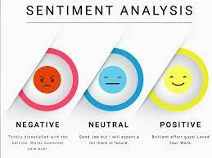
WHAT IS SENTIMENTAL ANALYSIS?
The method of identifying positive or negative sentiment in text is known as sentiment analysis.
Businesses frequently utilize it to
identify emotion in social data
assess brand reputation
comprehend customers.
Notes:
Reference: 5 Examples of Text Classification in Practice - Kavita Ganesan, PhD (kavita-ganesan.com)
What is Sentiment Analysis?
Sentiment analysis can be defined as analyzing the positive or negative sentiment of the customer in text. The contextual analysis of identifying information helps businesses understand their customers’ social sentiment by monitoring online conversations.
As customers express their reviews and thoughts about the brand more openly than ever before, sentiment analysis has become a powerful tool to monitor and understand online conversations. Analyzing customer feedback and reviews automatically through survey responses or social media discussions allows you to learn what makes your customer happy or disappointed. Further, you can use this analysis to tailor your products and services to meet your customer’s needs and make your brand successful.
Recent advancements in machine learning and deep learning have increased the efficiency of sentiment analysis algorithms. You can creatively use advanced artificial intelligence and machine learning tools for doing research and draw out the analysis.
For example, sentiment analysis can help you to automatically analyze 5000+ reviews about your brand by discovering whether your customer is happy or not satisfied by your pricing plans and customer services. Therefore, you can say that the application of sentiment is endless.

Slide 7
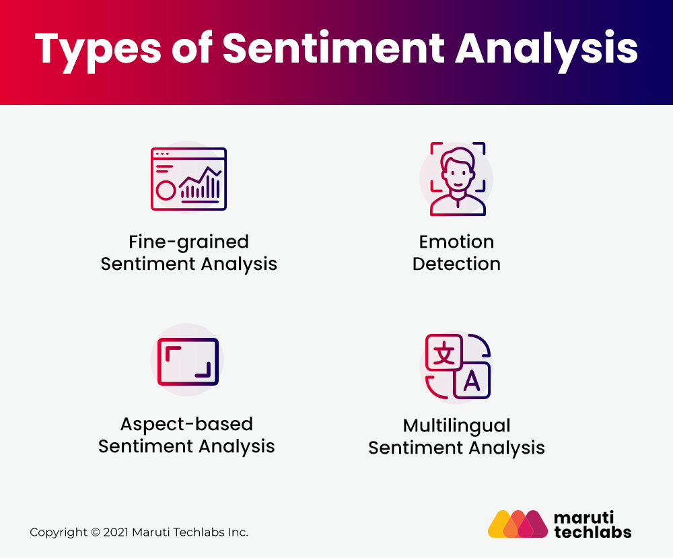
Types of Sentimental Analysis
Fine Grained Sentimental Analysis
Emotion Detection
Aspect Based Sentimental Analysis
Multilingual Sentimental Analysis
https://marutitech.com/introduction-to-sentiment-analysis/
Notes:
Sentiment analysis focuses on a text's polarity (positive, negative, or neutral), but it may also identify particular moods and emotions (angry, glad, sad, etc. ), urgency (urgent, not urgent), and even intents (interested v. not interested).
Reference: Introduction to Sentiment Analysis: Concept, Working, and Application (marutitech.com)
1. Fine-grained Sentiment Analysis
If your business requires the polarity precisions, then you can classify your polarity categories into the following parts:
Very positive
Positive
Neutral
Negative
Very Negative
For polarity analysis, you can use the 5-star ratings as a customer review where very positive refers to a five-star rating and very negative refers to a one-star rating.
2. Emotion Detection
This type of sentiment analysis helps to detect customer emotions like happiness, disappointment, anger, sadness, etc. Here, you can use sentiment lexicons or complex machine learning algorithms to identify the customer’s feelings.
One of the disadvantages of using sentiment lexicons is that people tend to express emotions in different ways. So, it may be confusing to understand human emotion clearly while using it.
3. Aspect-based Sentiment Analysis
Let’s say that you are analyzing customer sentiment using fine-grained analysis. You want to identify the particular aspect or features for which people are mentioning positive or negative reviews. Here, aspect-based sentiment analysis comes into play.
For instance, in the review “The camera quality of this phone is getting worse with time,” an aspect-based classifier will determine that the review expresses a negative opinion from the customer for the phone’s camera feature.
4. Multilingual Sentiment Analysis
Multilingual sentiment analysis is complex compared to others as it includes many preprocessing and resources available online (i.e., sentiment lexicons). Businesses value the feedback of the customer regardless of their geography or language. Therefore, multilingual sentiment analysis helps you identify customer sentiment irrespective of location or language difference.

Slide 8
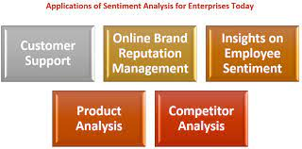
Applications of Sentimental Analysis
Customer Support
Online Brand Reputation Management
Insights on Employee Sentiment
Product Analysis
Competitor Analysis
https://www.3rdisearch.com/discover-real-world-applications-of-sentiment-analysis-technology
Notes:
Reference: Discover Real World Applications of Sentiment Analysis Technology | 3RDi Search Blog
1] Customer Support
For every enterprise today, customer support is a significant yet challenging responsibility, simply because of the need to attend to customer queries and the large number of queries that keep pouring everyday. Also, for an enterprise specializing in a diverse range of product and service offerings, attending to every query from the customers and segregating the queries under different categories, can also be a challenge. The solution is a sentiment analysis tool, powered by Natural Language Processing (NLP) which makes it possible for the sentiment analysis software to analyze and classify the customer queries and even respond to customer chats with preset menu of options for the customer to navigate.
2] Online Brand Reputation Management
When it comes to brand awareness online, sentiment analysis tools can play a significant role because these platforms have the power to identify negative reviews posted for your business online and alert you about the same. This way, you’re never too late to respond to poor reviews. Sentiment analysis software allows you to monitor responses on blogs and various social media channels. The data generated in the process can be used by enterprises. Also, online reputation management enables you to filter out the negative customer reviews with ease.
3] Insights on Employee Sentiment
With employee engagement a challenge for enterprises across the globe today, it is important for the HR of the organization to take steps towards making the employees feel more connected to their jobs and the organization. Understanding the issues and challenges is a good way to get started and the sentiment analysis tools make it possible for the HR to conduct surveys at the organizational level in order to identify the issues faced by the users.
4] Product Analysis
When a new product is launched or when you conduct a pre-launch market assessment seeking the response of prospective users towards your product, sentiment analysis tools can help you segregate the different kinds of feedback that you receive. In fact, this can be a great application of a sentiment analysis tool as manually sifting through thousands of feedbacks to form a collective insight can be next to impossible when carried out manually.
5] Competitor Analysis
Market research or competitor analysis is another key application of sentiment analysis technology. The ability of sentiment analysis tools to detect the sentiment of large volumes of data can be useful to figure out market trends, what's working for your target audience and what's not. Also, this technology can provide you insights on the aspects of the competitors' products or services that the target audience finds the most useful. This can be a great way to analyze the strengths and weaknesses of your own product and services, knowing what works and what doesn't.

Slide 9
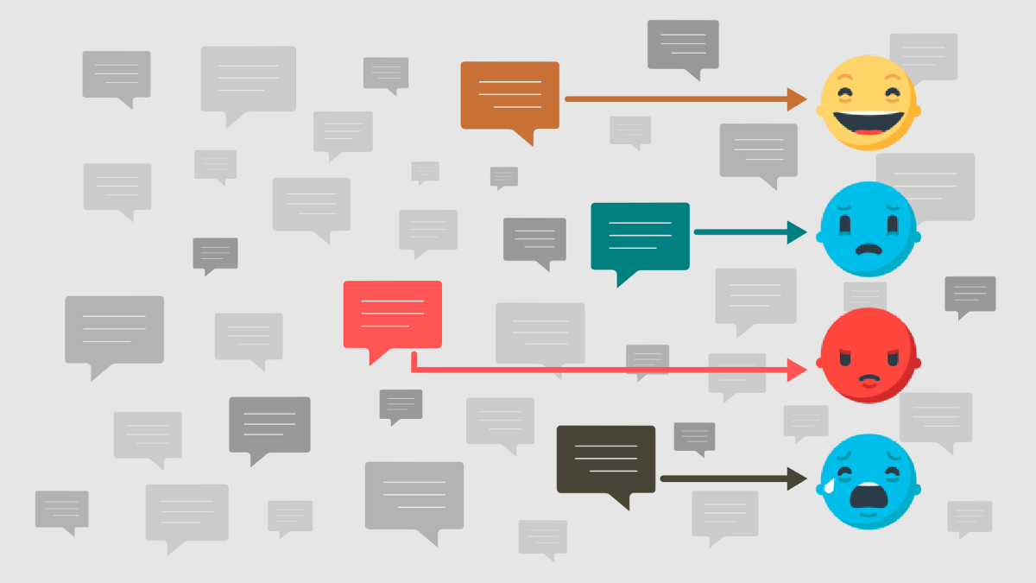
DL Models
The main DL models used for Sentimental Analysis are:
LSTM
RNN
Notes:
Reference: Deep Learning Models for Sentiment Analysis - Meltwater Engineering Blog
LSTM: Long short term memory
RNN: Recurrent neural network

Slide 10
Long Short Term Memory Networks (LSTMs)
Long-term dependencies may be learned and remembered using LSTMs, which are a form of Recurrent Neural Network (RNN).
The default habit is to recall prior knowledge over lengthy periods of time.
LSTMs keep track of data throughout time. Because they recall past inputs, they are valuable in time-series prediction.
Four interacting layers communicate in a unique way in LSTMs, which have a chain-like structure.
LSTMs are commonly employed for voice recognition, music creation, and pharmaceutical research, in addition to time-series predictions.

Slide 11
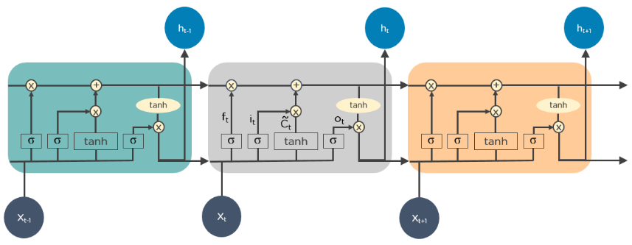
How Do LSTMs Work?
First, they forget about non-essential aspects of the prior condition.
They then update the cell-state values on a case-by-case basis.
Finally, the status of several portions of the cell's output
The following is a diagram illustrating how LSTMs work:

Slide 12
Recurrent Neural Networks (RNNs)
The outputs from the LSTM may be given as inputs to the current phase since RNNs contain connections that create directed cycles.
The LSTM's output becomes an input to the current phase, and its internal memory allows it to remember prior inputs.
Image captioning, time-series analysis, natural-language processing, handwriting identification, and machine translation are all typical uses for RNNs.

Slide 13
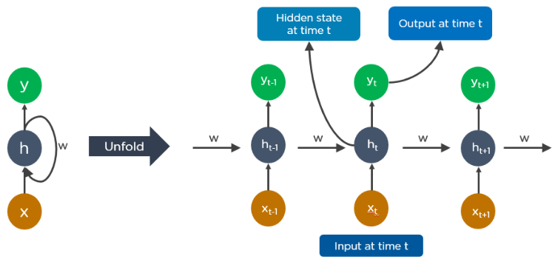
Unfolded RNN

Slide 14
Working of RNN
At time t-1, the output feeds into the input at time t.
The output at time t feeds into the input at time t+1 in the same way.
RNNs can handle any length of input.
The algorithm takes into consideration past data, and the model size does not grow in proportion to the input size.

Slide 15
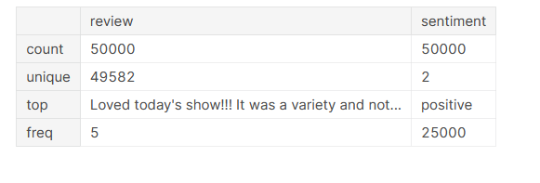
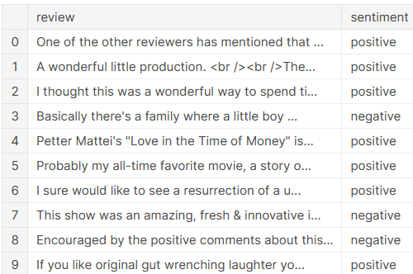
CASE STUDY: Sentimental Analysis on IMDb Database
IMDB dataset -50K movie reviews
Dataset for binary sentiment classification
25,000 for training and 25,000 for testing
Prediction of positive/negative reviews

Slide 16
References
https://www.cs.ryerson.ca/~aharley/vis/
https://setosa.io/ev/image-kernels/
https://towardsdatascience.com/understand-transposed-convolutions-and-build-your-own-transposed-convolution-layer-from-scratch-4f5d97b2967
https://www.simplilearn.com/tutorials/deep-learning-tutorial/deep-learning-algorithm
https://medium.com/voice-tech-podcast/text-classification-using-cnn-9ade8155dfb9

Slide 17

Notes:
Here are the lessons we are going to learn today.

